Slide 1
Work in Progress Wellness App
Findings & Recommendations
Module 15 Challenge

Slide 2
Findings: NPS Score
NPS scores declined over the course of the five-week beta test, with Q3 showing the lowest score of 19.
The Q3 NPS score of 19 indicates a decrease in customer loyalty and advocacy compared to the scores of 31 and 30 in Q1 and Q2, respectively.
The Q3 NPS score of 19 falls below the industry average NPS of 44, suggesting that customers are less satisfied with the telehealth scheduling feature.
The declining trend in NPS scores indicates a need for improvement in customer experience and satisfaction with the scheduling feature.
Qualitative feedback suggests issues with finding available appointments, lack of information about therapists, and difficulties in navigating and using the feature.
Students (Users) | NPS
Q1 | 31
Q2 | 30
Q3* | 19
Industry Avg. NPS: | 44
* customer feedback from beta test of the new scheduling feature

Slide 3
Findings: CSAT
CSAT scores also decreased from 47% in Q1 to 39% in Q3, indicating a decline in overall customer satisfaction with the telehealth scheduling feature.
The Q3 CSAT score of 39% falls below the target CSAT score of 80%, indicating significant room for improvement.
The decline in CSAT scores further highlights the need to address customer concerns and enhance the usability of the scheduling feature.
Qualitative feedback points to issues such as difficulty in finding appointments, lack of information about therapists, and limitations in filtering options for preferences.
The feedback suggests that customers desire a more user-friendly experience and more detailed information to make informed choices.
Students (Users) | CSAT
Q1 | 47%
Q2 | 45%
Q3* | 39%
Target CSAT: | 80%
* customer feedback from beta test of the new scheduling feature

Slide 4
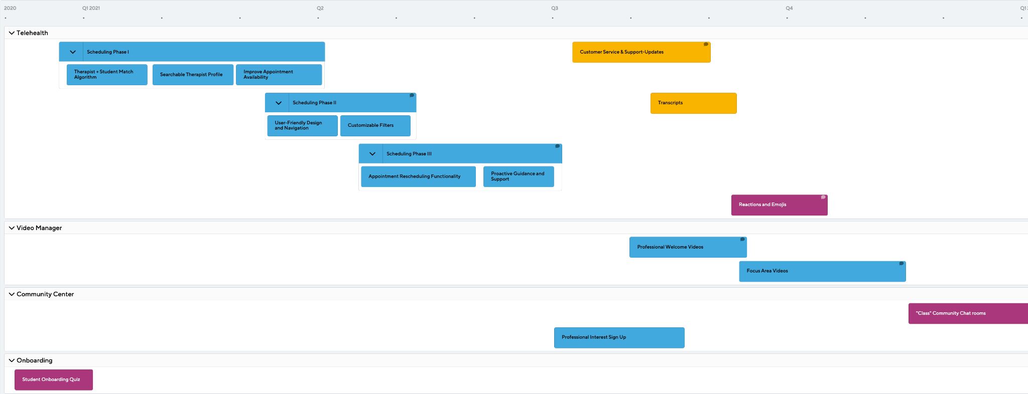
Work In Progress Roadmap

Slide 5
Recommendations & Next Steps
Implement a Seamless Onboarding Process
Conduct User Research
Monitor and Analyze User Engagement Data
Create a user-friendly onboarding process that guides new users through the app's features and functionalities.
Provide clear instructions on how to access and use the scheduling feature.
Conduct in-depth user research to understand the specific needs, preferences, and pain points of the target audience.
Gather insights through surveys, interviews, or usability testing to inform future roadmap decisions.
Implement analytics tools to track user engagement and behavior within the app, specifically focusing on the telehealth scheduling feature.
Monitor metrics such as appointment conversion rates, user drop-off points, and user session duration. Analyze this data to identify bottlenecks or areas for improvement.

